Slide 1
News Hunter
Subject : System Design Practice
B. Tech. CE Semester - IV
Prepared By:
Aastha Patel - CE001
Priyavardhan Panchal - CE086
Mauneel Sorathia - CE133

Slide 2
Abstract
Our project title is “News Hunter”. It is a web scraper for fetching latest news.
Web Scraping is the process of collecting structured web data in an automated fashion. It’s also called web data extraction. A web scraper is a specialized tool designed to accurately and quickly extract data from a web page.
Basically our project is one of the applications of web scraping. We are web scraping the latest news articles from different websites, distinguishing their categories using ML model and show them category-wise on our web application.

Slide 3
Tools and Technologies used
For Frontend : HTML5, CSS3, Bootstrap, Javascript
Backend framework : Django
Backend Database : MongoDB (NoSQL database)
Python Libraries used : Beautiful Soup, Scikit -learn, Keras, Pymongo, Profanity filter, django-webpush
APIs used : OpenWeatherMap API
Platform used for version control : Github

Slide 4
Modules and Work division
Modules | Owner
Web scraping news | Priyavardhan
Extract headlines, images, content and store in database | Priyavardhan
Fetching news and display on homepage | Priyavardhan
Updating news at regular interval and deleting older news | Priyavardhan
Show weather report | Priyavardhan

Slide 5
Modules | Owner
Develop classification Model for identifying categories | Aastha
Integrating model with the web application | Aastha
User Interface, Logo and Favicon Design | Mauneel
Admin Module | Mauneel
Push notification | Mauneel
Search functionality | Mauneel

Slide 6
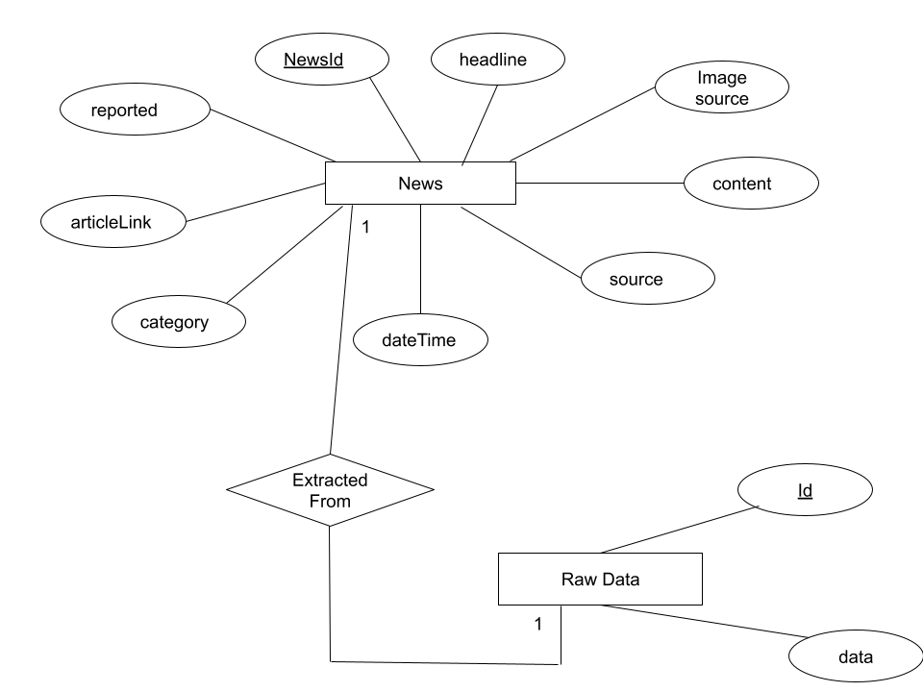
Entity Relationship
diagram
￼

Slide 7
Data
Dictionary
Field Name | Data type | Constraint | Description
For News Table
NewsID | Number | Primary key | Identity
Headline | varchar | Not null | News Headline
Content | varchar | - | News Details
Image source | varchar | Not null | Image link
Source | varchar | Not null | Source of news
DateTime | DateTime | Not null | DateTime of news
Category | varchar | - | News Category
Article_link | varchar | Not null | Website Link from which news is extracted
Reported | Boolean | - | Whether the news is reported by some user

Slide 8
Implementation

Slide 9
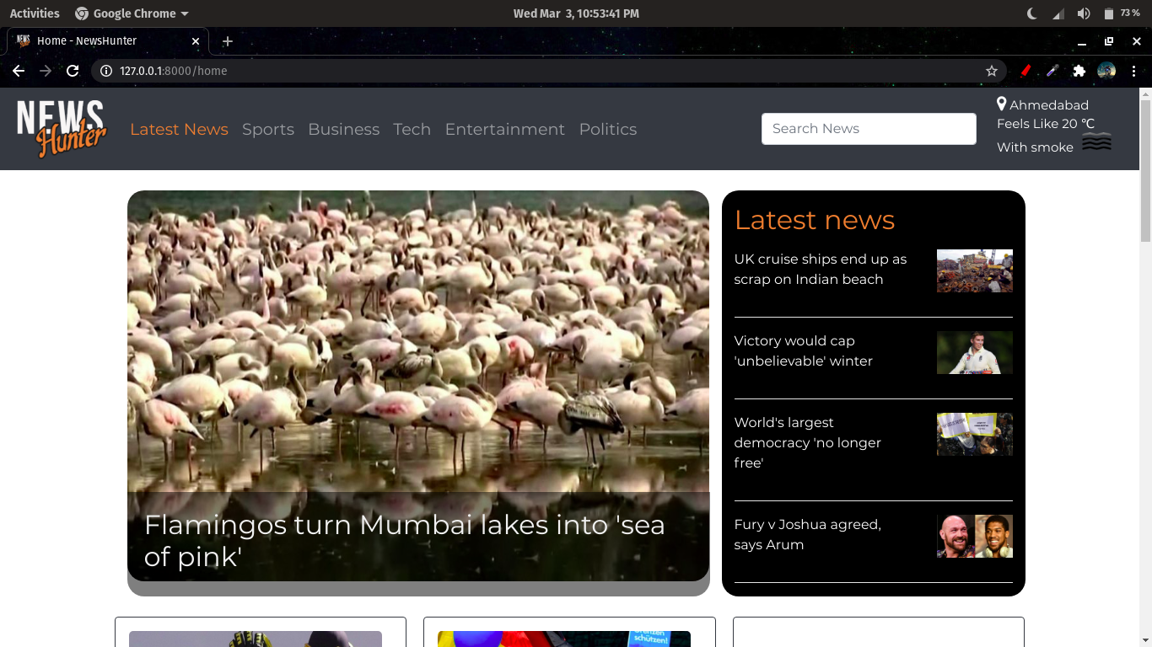
Web scraping news from websites and displaying on webpage

Slide 10
Web scraping
In our web-application, we are fetching news from 4 urls as shown and content is scraped from the pages and is stored in respective variables.
url1 = 'https://timesofindia.indiatimes.com/news'
url2 = 'https://www.thehindu.com/news/'
url3 = 'https://www.thehindu.com/'
url4 = 'https://www.bbc.com'
page1 = requests.get(url1)
page2 = requests.get(url2)
page3 = requests.get(url3)
page4 = requests.get(url4)
Further, the headline, image source, article link, source, Datetime is extracted from the html source code and stored in a python dictionary.
Likewise, news from all the websites are stored in the given format and add in a list - “news”.

Slide 11
Adding news to database : Next, connection is established with mongodb and the list of news is stored in the database.
Updating news : On every run of the python script, 58 news are fetched from the websites and the unique news are only added in the database to avoid redundancy.
Deleting older news : The news which is older than 36 hours will be discarded from the database.
# Delete news with duration more than 36 hrs(129600 seconds)
if duration>129600:
mycol.delete_one({'Headline' : i['Headline']})

Slide 12

2. Show weather report

Slide 13
On the homepage, a weather report is shown using the OpenWeatherMap api which takes the location as input and gives the temperature(in Kelvin), humidity, weather and icon which is displayed in the top right corner of the webpage.
import requests
response = requests.get('http://api.openweathermap.org/data/2.5/weather?q='+city+'&APPID=46c58e3eded12aaeb86c8287b19e4de5')
weather_report = {}
if response.status_code == 200:
data = response.json()
main = data['main']
weather_report['city'] = city
weather_report['temp'] = int(main['feels_like'] - 273.15)
weather_report['humidity'] = main['humidity']
weather_report['weather'] = data['weather'][0]['description']
weather_report['icon'] = data['weather'][0]['icon']
return weather_report

Slide 14
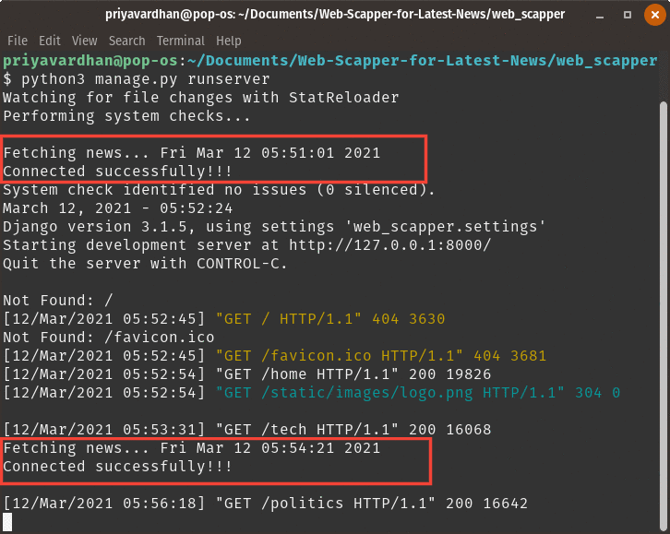
3. Update news at regular interval

Slide 15
In django, some files like urls.py, settings.py are executed on startup only once, so to run the script for fetching news, the command is added in the urls.py file to run the script.
To run the script at a regular interval of time, the concept of threading and timer in python is used which will create a thread and will run the script in background repeatedly after every ‘n’ seconds provided in the parameters. And the parent thread will continue to run the server.
import time
import threading
import os
def startup():
threading.Timer(200.0, startup).start()
print("Fetching news..." , time.ctime(time.time()))
os.system('python3 latest_news/fetch_news.py')
startup()

Slide 16
4. Figuring out the category of the news
For this, we have trained a multi-class classification model using the Logistic Regression algorithm. The model takes news headline as an input and gives the category as an output. Our model basically divides the news into 5 categories :
Politics
Business
Entertainment
Sports
Tech
The training of the model is done as follows :
Tokenizing our dataset using Tf-idfVectorizer : It stands for Term Frequency Inverse Document Frequency. In TfidfVectorizer we consider overall document weightage of a word. It helps us in dealing with most frequent words. Using it we can penalize them. TfidfVectorizer weights the word counts by a measure of how often they appear in the documents.

Slide 17
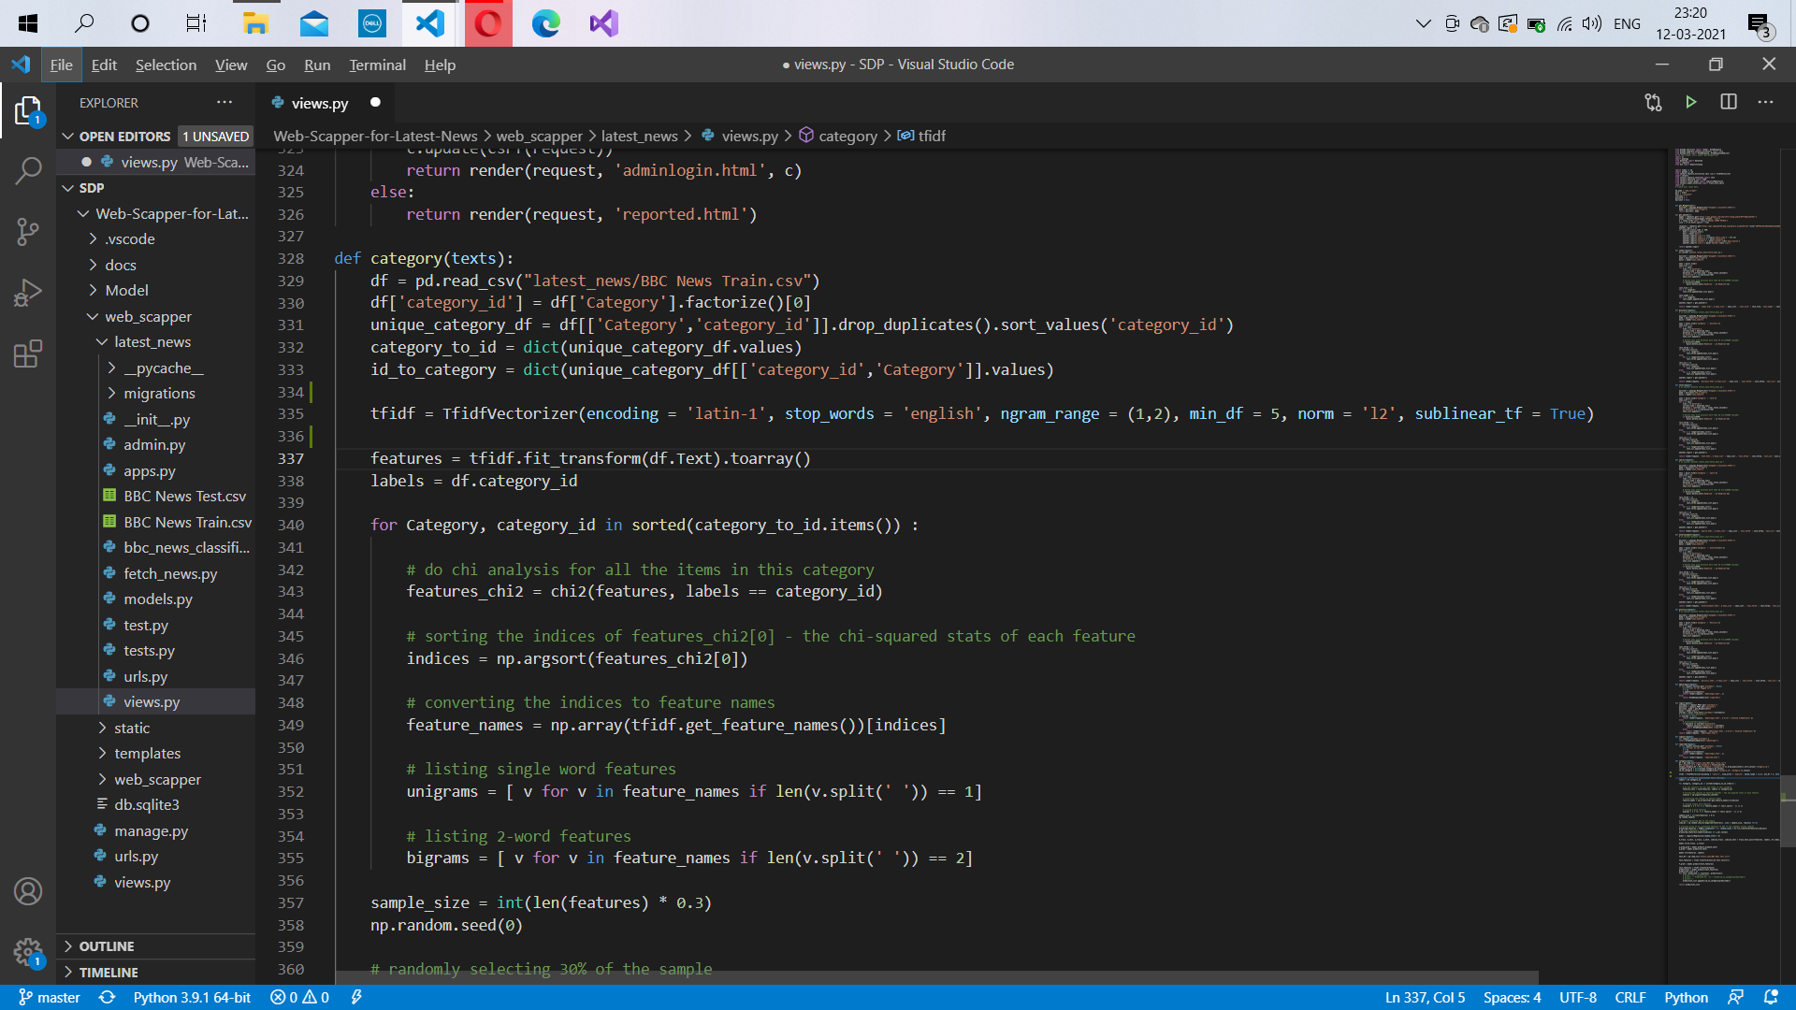
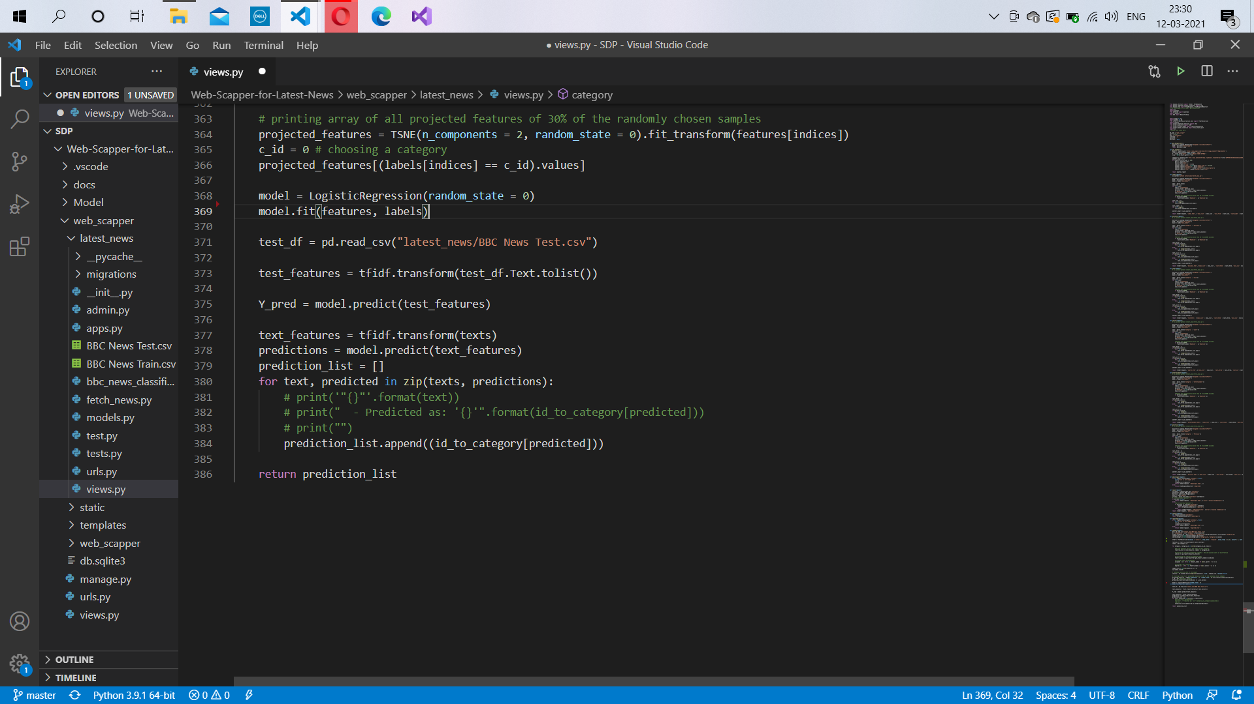
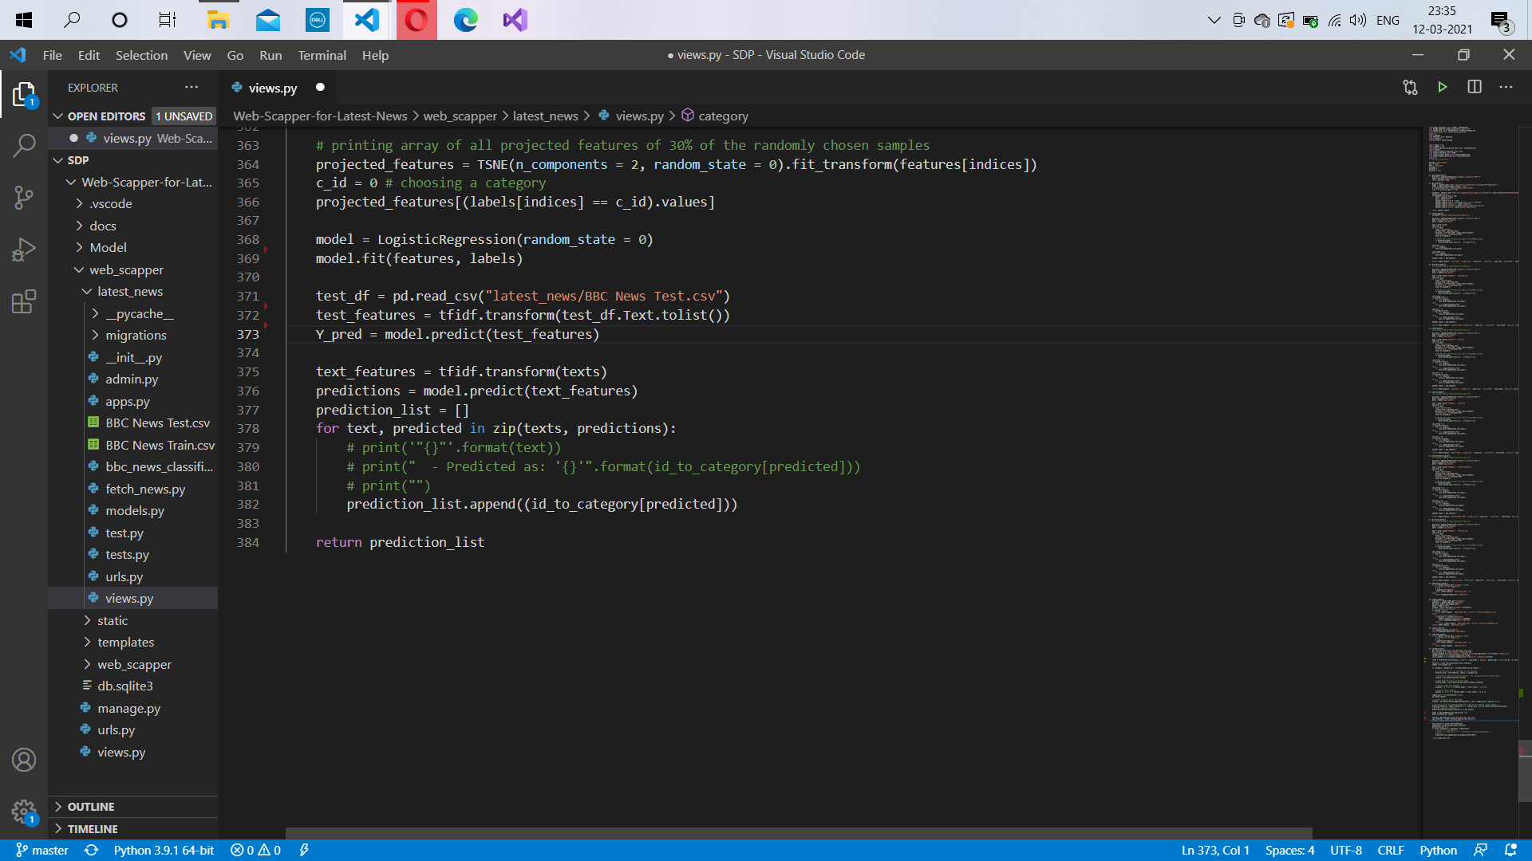
2. Preparing the features and labels matrix.
3. Fitting the Model.
4. Predicting our outputs using the test dataset.

Slide 18
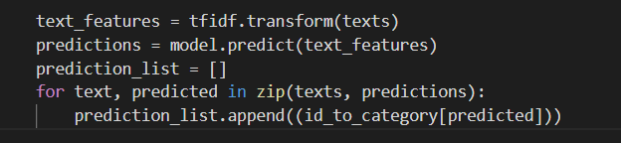
5. Writing the code which gives us the list of predicted categories .
Well, the whole code for model training is written in a function called category, which takes list of headlines as an argument , and that list is used in the above code. Now the above code returns the predicted categories in the form of a list i.e. prediction_list .
This category() function is called in the fetch_news.py file where scrapping work takes place and the output is stored in a variable and then the predicted category is stored in the database along with the news headline.

Slide 19
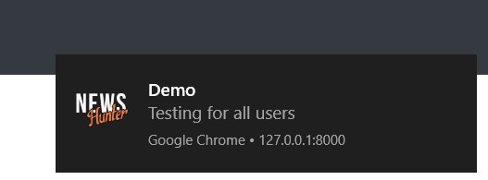
5. Push Notifications

Slide 20
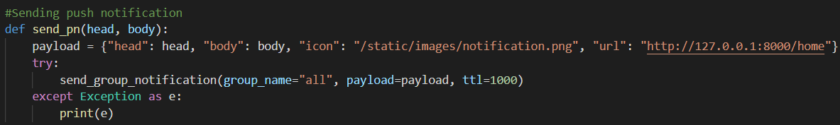
● It uses “django-webpush” package for sending push notification
● send_pn() method forms a payload of header, body, icon and url of the notification.
● It uses send_group_notification() method of “webpush” library to send notification to
users of group “all” with payload and ttl is time for which this notification will be
stored by web push server.

Slide 21
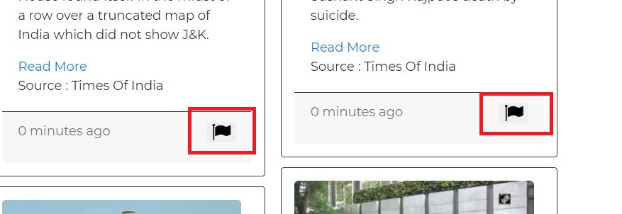
6. Reporting News

Slide 22
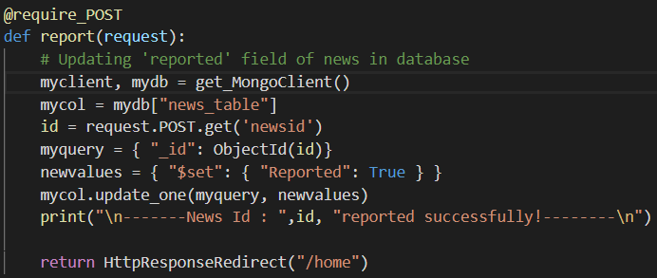
● User can report a news by clicking on ‘flag’ icon
● Admin will be able to see the reported news and can delete it.
● So, the report() method will get id of the news from the template and will update the
news with “Reported” field equals to true.
● All news having “Reported” true will be shown to the admin.

Slide 23
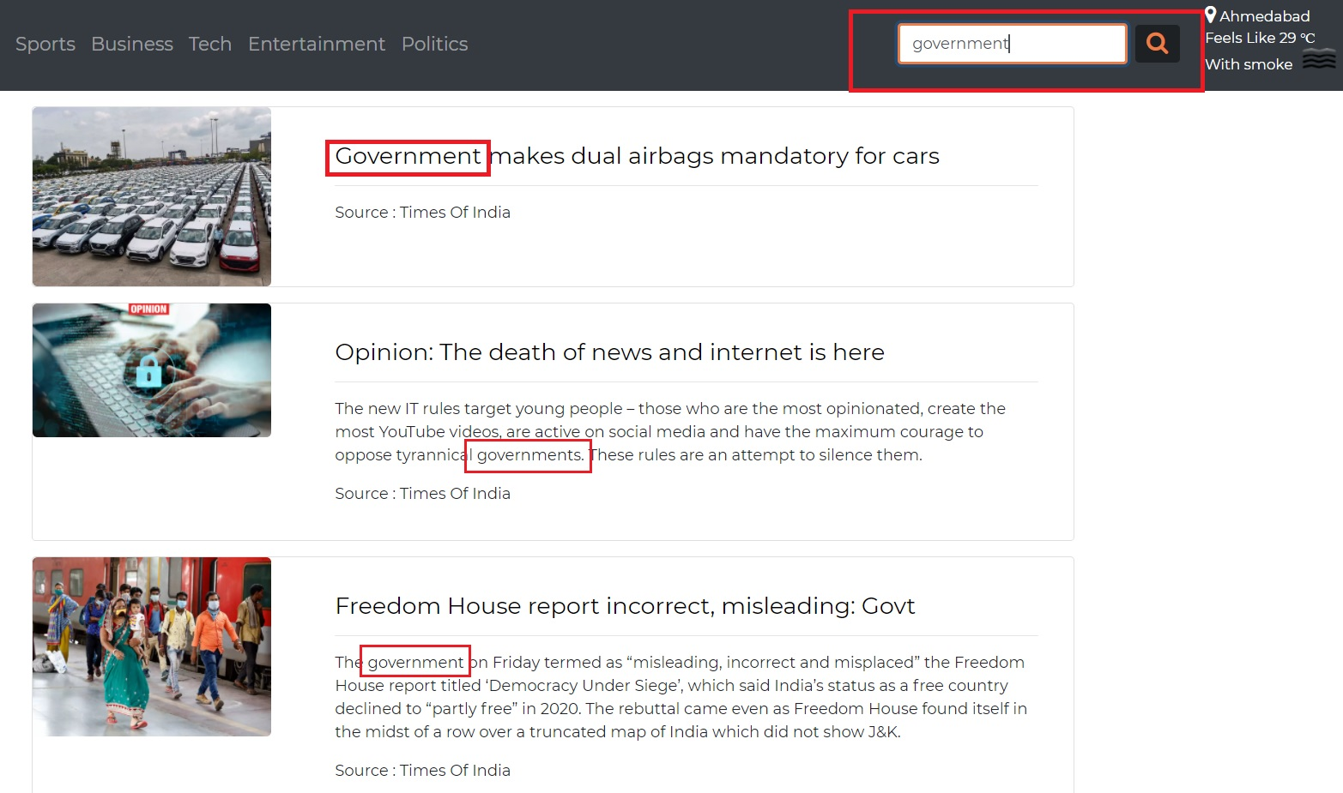
7. Search News

Slide 24
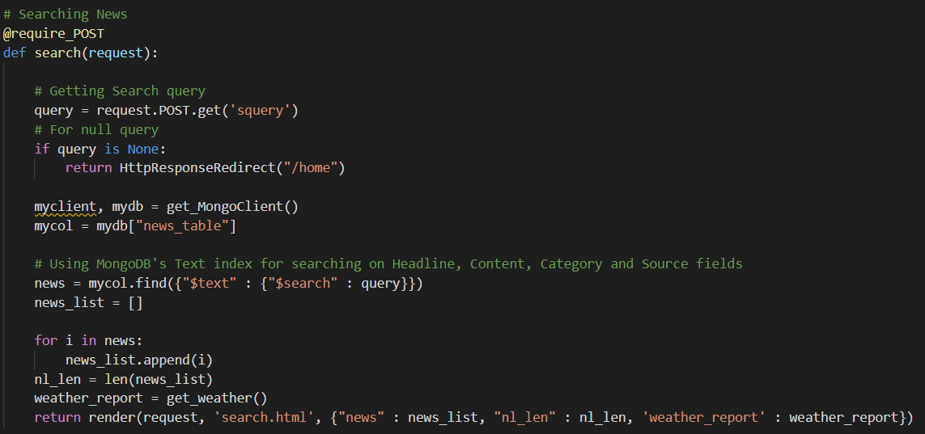

Slide 25
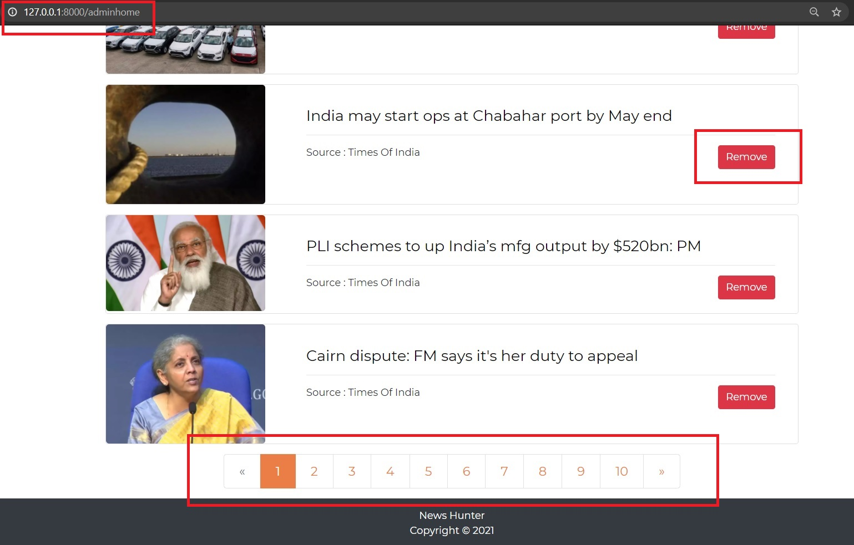
8. Admin Module

Slide 26
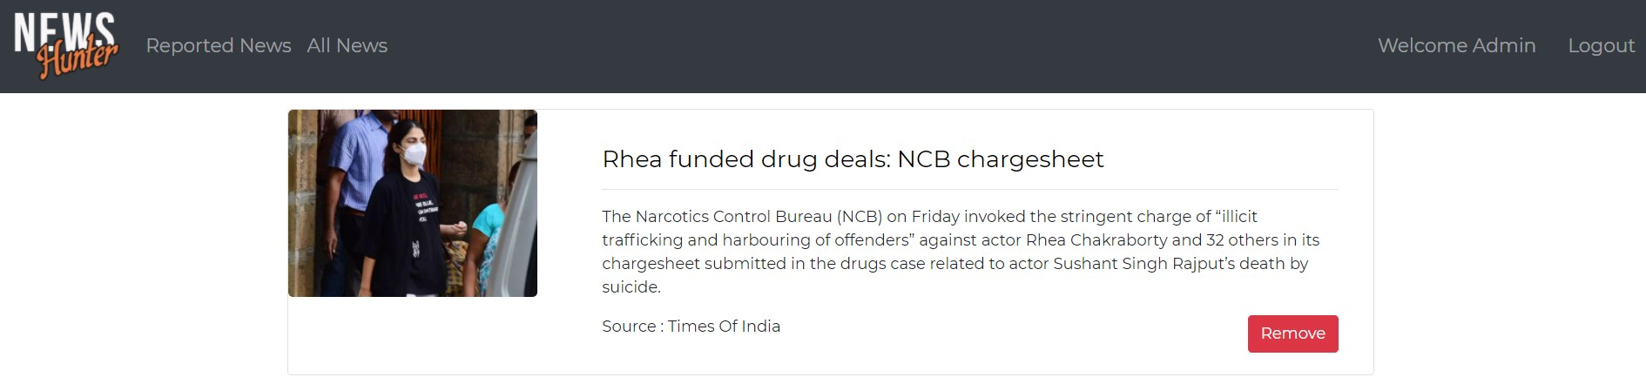
9. Admin can view reported news and delete it.

Slide 27
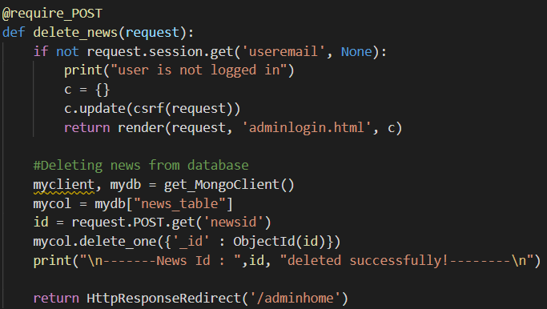

Slide 28
Thank You

